Slide 1
Retail Sales Analysis
Dashboard

Slide 2
Business problem
Retail businesses generate large amounts of sales data, but it is difficult to understand overall performance, customer behavior, and product profitability without proper analysis.
The main challenges are:
Identifying which categories and products generate the highest revenue and profit.
Understanding customer segments and their purchasing behavior.
Analyzing sales trends over time to support decision-making.
Evaluating the impact of discounts on revenue and profitability.
Monitoring return rates and improving customer satisfaction.
This project aims to build an interactive Power BI dashboard to transform raw sales data into actionable insights and help business teams make data-driven decisions.

Slide 3

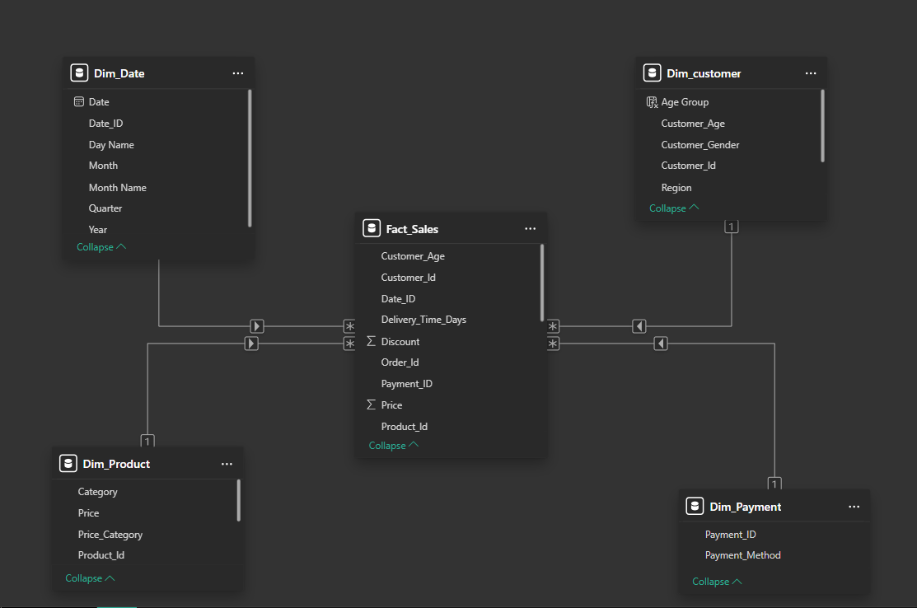

Data model
Built using Star Schema architecture.
Fact table stores sales transactions.
Dimension tables provide descriptive attributes for analysis.
One-to-many relationships ensure accurate filtering and reporting

Slide 4
dashboard

Slide 5
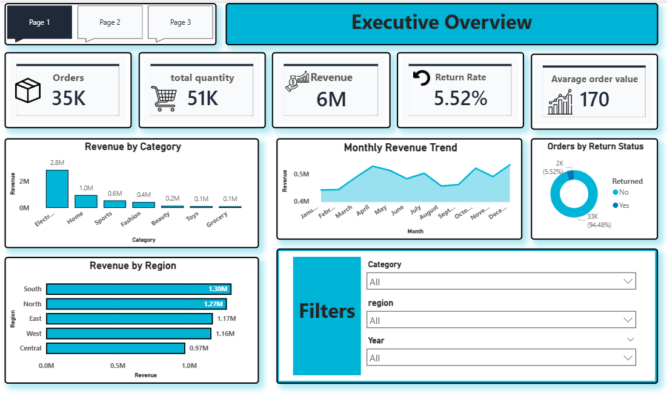

Slide 6
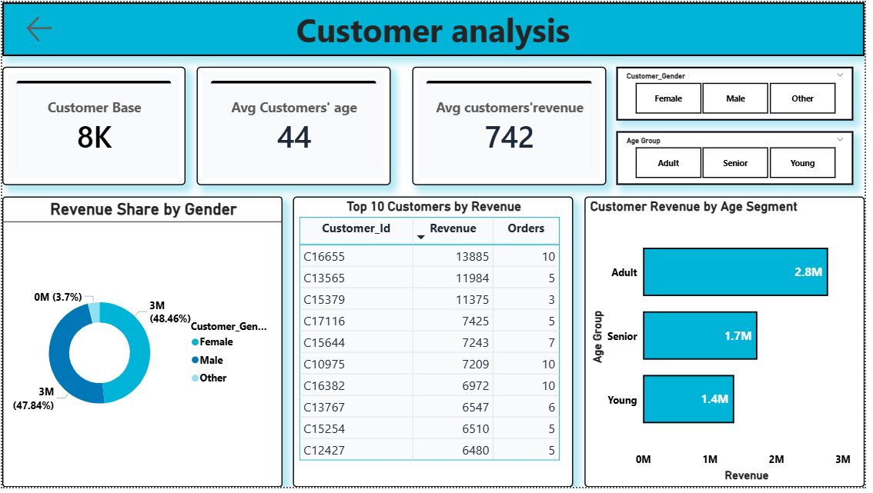

Slide 7
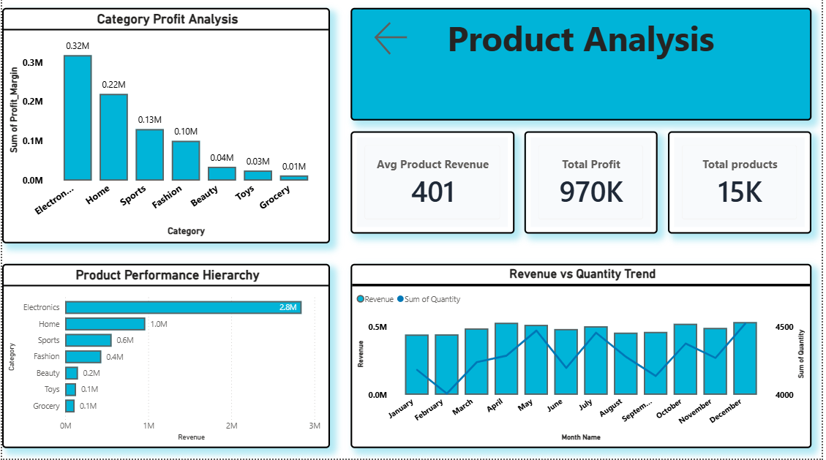

Slide 8
Key Insights
Total Revenue reached 6M with 35K Orders, showing strong sales performance.
Electronics is the top-performing category in both revenue and profit.
Adult customers contribute the highest revenue compared to other age groups.
Customer revenue is almost balanced between Male and Female segments.
The overall Return Rate is low (5.52%), indicating good order completion.
A few top products generate a significant share of revenue, making them important for business focus.
High-profit categories should be prioritized to improve overall profitability

Slide 9
Recommendations
Focus on top-selling categories and products.
Optimize discounts to increase sales while maintaining profit margins.
Target customer segments with lower contribution to improve growth.
Maintain inventory availability for high-performing products.

